Slide 1
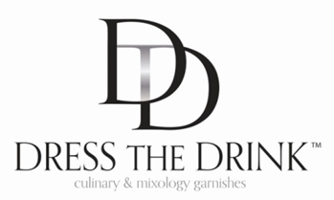
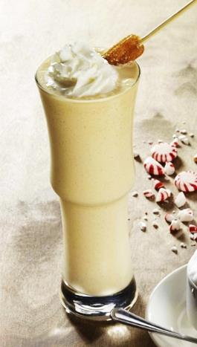
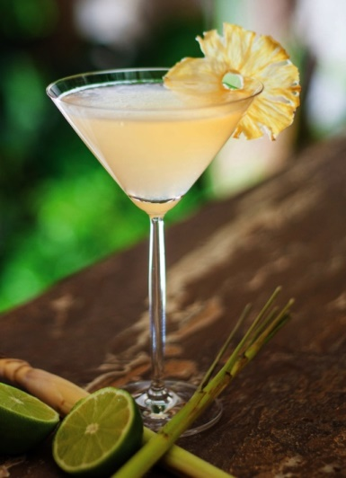
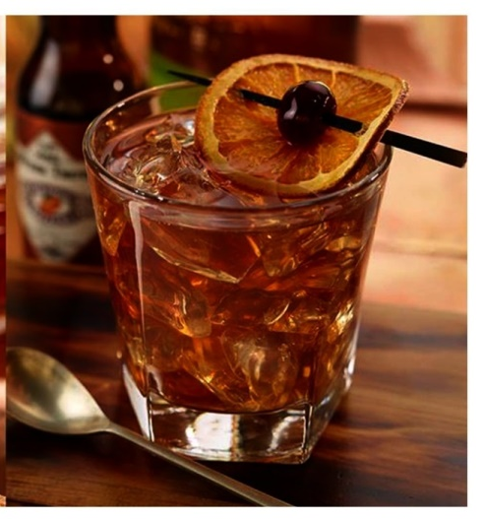
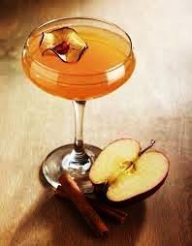
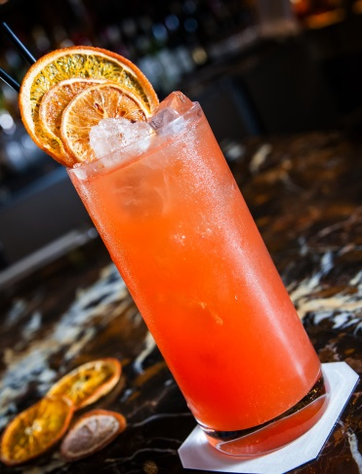
INTRODUCING THE PERFECT PAIRING…
Current Sampling Deck 2015

Slide 2
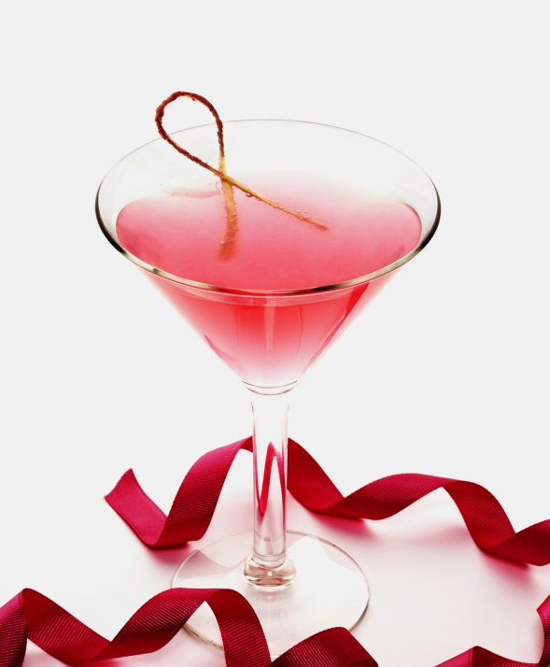
DTD SERVICE OFFERINGS
■ Customized Hand Crafted Blends & Garnish Development
■ Beverage Innovation Development
Check Out Our Newest Blends & Garnish Offerings

Slide 3
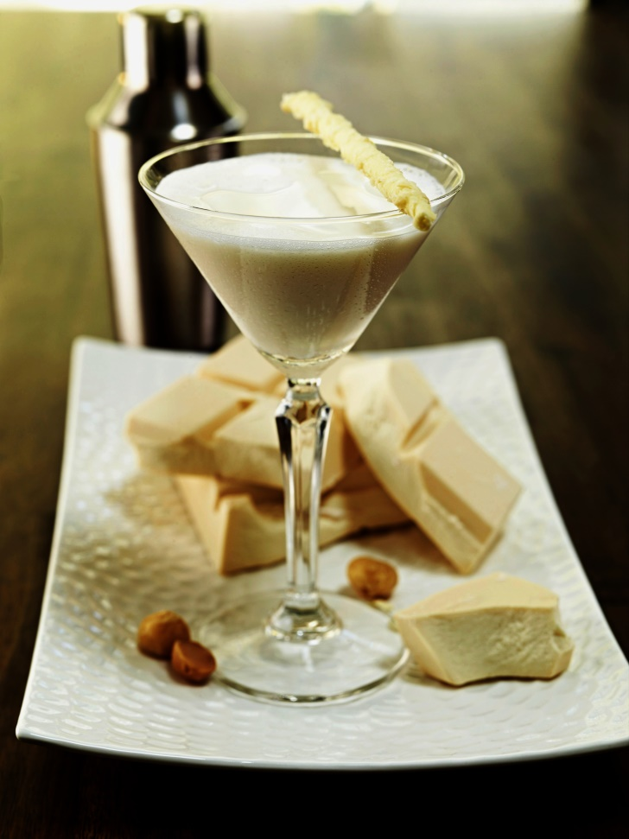
DTD UNPARALLELED CREATIVE DECADENT PRODUCT
INSPIRATIONS
Dress The Drink™ (DTD)
is all about pairing culinary and mixology. From signature cocktail creations to the whole dining experience.
A producer of proprietary artisanal, hand crafted, all natural, non-wasteful garnishes and blends.
DTD uses color, flavors, textures, infusions, and the mastering of blends that bring together the true art of culinary and mixology pairings.

Slide 4
■ DTD introduction deck is a flavor teaser of some of DTD core products. DTD’s business is built on 90% custom products that DTD will flavor profile per your new beverage or food development projects.
■ New product concept development programs.
■ Optional re-dressing existing drink or food programs.
■ Project management included in product deck pricing.
■ Spirit brand support from DTD alliance partnering.
■ Retail and private label program offerings.
■ Pricing is based on volume programming per product placement.

Slide 5
DTD NEW BLENDS
DTD Cucumber, Rosemary, Juniper Berry hints of Sea Salt and White Sugar
DTD Warm Spices
DTD Cinnamon, Allspice, Cloves with hints of Rosemary, Sea Salt and White Sugar
DTD Crushed Rosemary, Green Tea, Honey, Citrus Zest with hints of Sea Salt and White Sugar
DTD Crushed Basil, Coconut, Lemon Zest with hints of Sea Salt and White Sugar
DTD Crushed Strawberry, Rhubarb, Basil with hints of Sea Salt and White Sugar
DTD Crushed Basil, Lemongrass, Lemon Zest with hints of Sea Salt
DTD Pineapple, Coconut, Mint with hints of Sea Salt and White Sugar
DTD Mint, Clover, Thyme with hints of Lemon Zest Sea Salt and White Sugar
DTD Crushed Mint, Green Tea, Lemon Zest with hints of White Sugar
DTD Crushed Cucumber, Ginger, Lemon Zest with hints of Sea Salt and White Sugar
DTD Cranberry, Lemon and Orange Zest with hints of White Sugar
DTD Caramel Apple, Lemon Zest accented with Light Golden Sugar and hints of Edible Gold
DTD Peach, Honey, Vanilla with hints of Golden Sugar
DTD Blood Orange. Cinnamon and White Sugar
DTD Very Berry, Mint and White Sugar
DTD Crushed Edible Flowers, Cardamom, Lavender with hints of Sea Salt and White Sugar
DTD Apricot, Fig with hints of Clove and Honey
DTD Crushed Pineapple, Lychee, Coconut, Lime Zest and White Sugar
DTD Key Lime Pie
DTD Toasted Coconut with hints of Pineapple, Orange Zest, Mint and White Cane Sugar
DTD Sweet Hot Citrus Zest
DTD Olive, Garlic, Basil hints of Black and White Lava Salt
DTD Spicy Mango with hints of Black Lava Salt
DTD Black and White Lava Sea Salt with hints of Lime Zest and Silver Flakes
Black and White Lava Sea Salt with hints of Lime, Lemon, Zest and Silver Flakes
Black and White Lava Sea Salt with hints of Lime, and Grapefruit Zest and Silver Flakes
DTD Black and White Lava Sea Salt with hints of Lime, Lemon, Grapefruit, Orange Zest and Silver Flakes
DTD Sour Apple, Pear, Cherry, Apricot, Lemongrass accented with White Sugar and Edible Gold

Slide 6
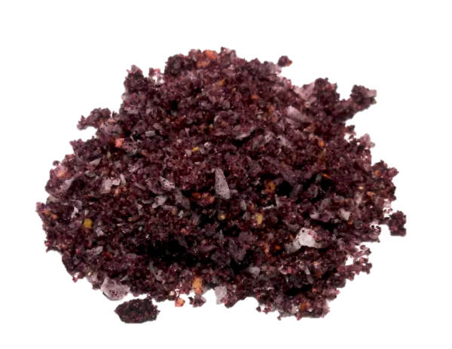
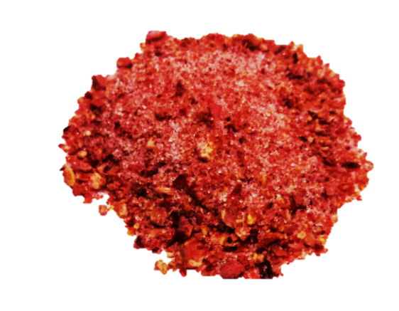
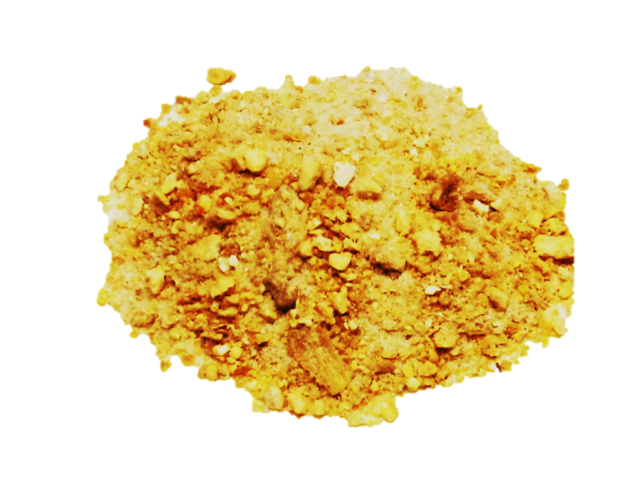
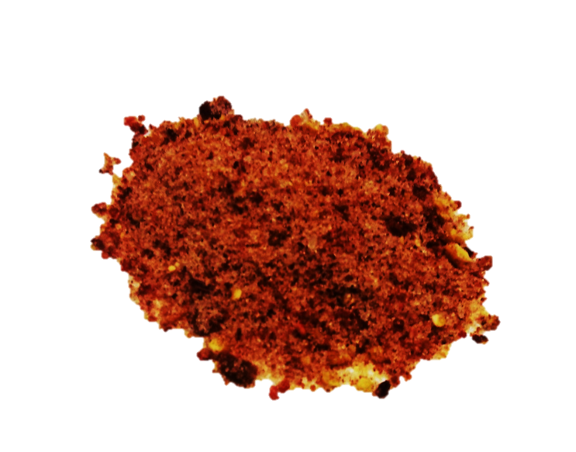
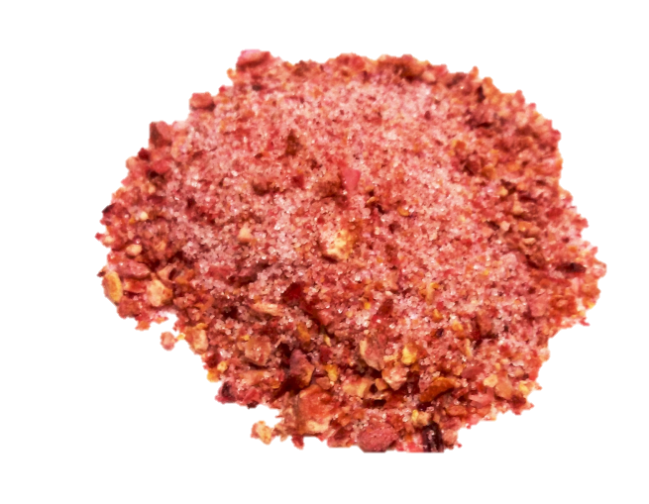
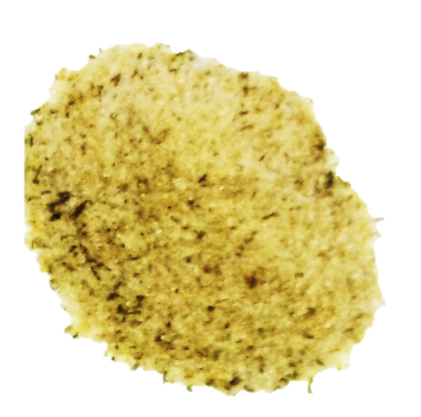
Sample Collection
DTD Newest Blends
Blueberry Wasabi
Flower Hibiscus
Mango Pineapple
Strawberry Basil
Tomato Basil
Coconut Basil
No Limitations!
Flavor profiles to meet any beverage creation.
Customized profiles available.

Slide 7
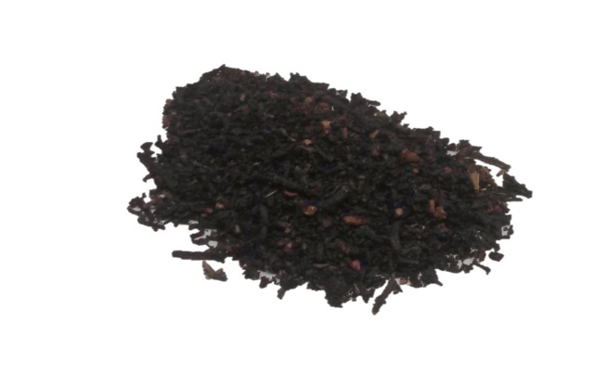
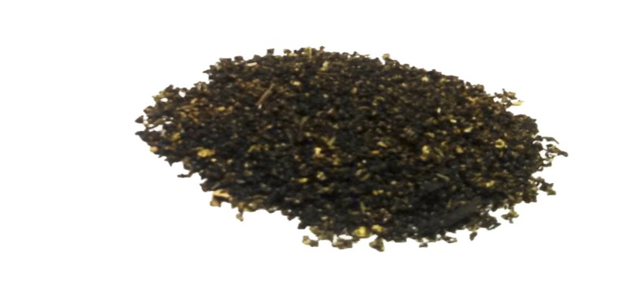
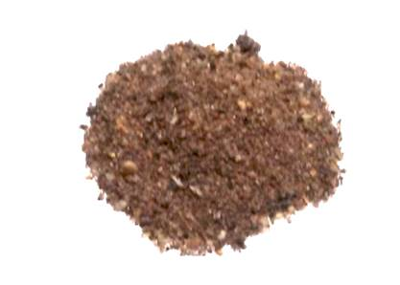
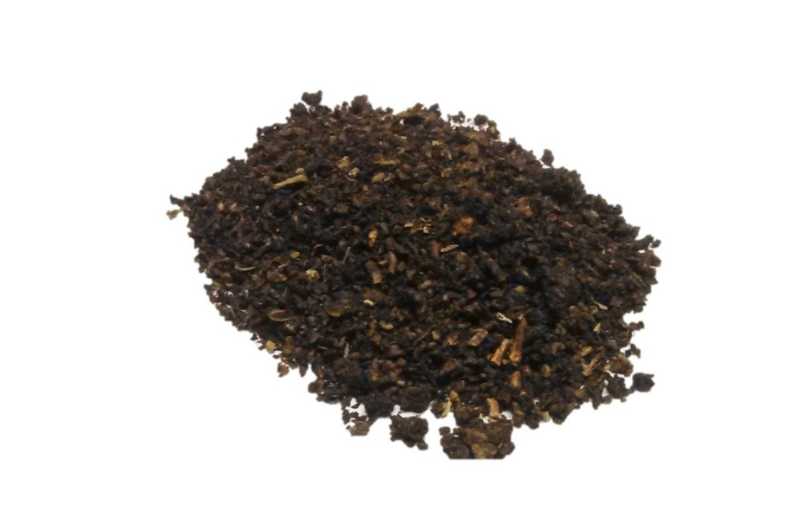
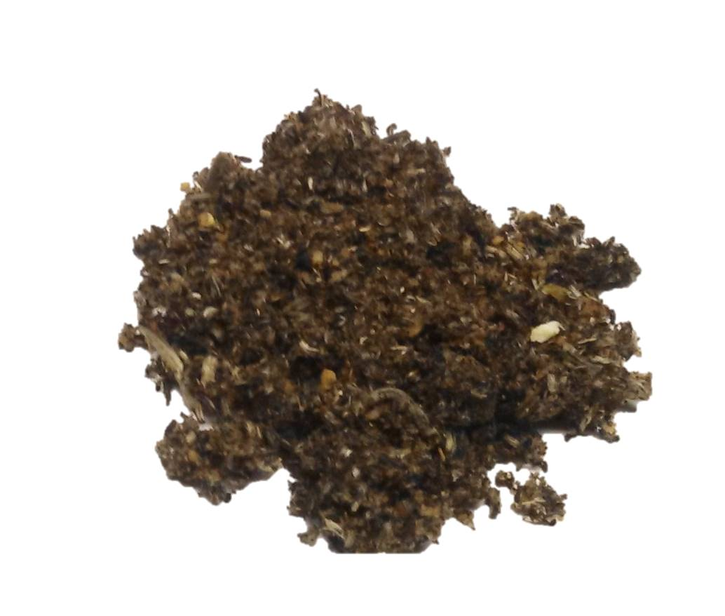
Sample Collection
DTD Newest Tea Infusions – Customized Collection
Create a delish beverage offering with tea infusion adding simple syrup or agave!
Black Blueberry Mint Peppercorn
Green Citrus Coconut Mango Pineapple
Vanilla Lavender Flower Hibiscus
Oolong Raspberry Lemon and Lime Zest
White Blood Orange Ginger
No Limitations!
Flavor profiles to meet any beverage creation.
Customized profiles available.

Slide 8
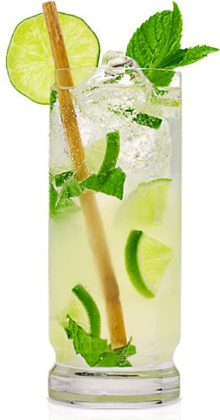
DTD NEW GARNISHES Imagine always getting to create the perfect accessory…
DTD Beaded Honey Clusters
DTD Lemon Ginger Beaded Cluster
DTD Strawberry Basil Icicle Stirrer
DTD Lemon Zest Icicle Stirrer
DTD Lime Zest icicle Stirrer
DTD Orange Zest Icicle Stirrer
DTD Olive Sea Salt icicle Stirrer
DTD Cucumber Mint Icicle
DTD Key Lime icicle Stirrer
DTD Pineapple Coconut Icicle Stirrer
DTD Cinnamon Orange Sugar Spice
DTD Candied Star Fruit with hints of edible Gold
DTD Candied Lemon accented with Coconut Basil with hints of Sea Salt
DTD Asian Pear infused with Green Tea accented with Lemon Zest Dusting
DTD Chocolate Basil Coconut Stirrer
DTD Candied Blood Orange dusted in Blood Orange Zest, Ginger with hints of White Sugar
DTD Candied Pineapple accented with Lychee, Coconut, Lime Zest Wheel
DTD Candied Date Apricot Bite
DTD Golden Fig Apricot
DTD Jalapeño Pepper Chip
DTD Candied Banana, Fig, Coconut St
DTD Flower Apple Bud | Any Flavor profile
DTD Pretzel Stick accented with Peanut Butter Mouse, Bacon and Chocolate

Slide 9
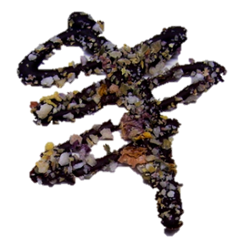
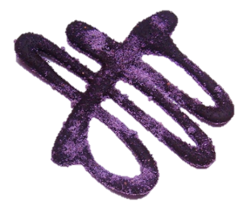
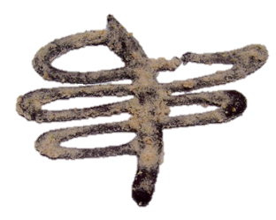
Sample Collection
Too Many Flavor Profiles to List
DTD Newest Chocolate Garnishes
White or Milk Chocolate Pistachio Nut Raspberry
Dark Chocolate Orange Zest Cranberry Sea Salt
White or Dark Chocolate Cherry Coconut
White or Dark Chocolate Basil Lava Sea Salt Stick
White or Dark Chocolate Apricot Almond
White or Milk Chocolate Crushed Edible Flowers with Ginger and Lemon Zest
Peanut Butter Chocolate Mouse Pretzel
Swirl Designs - Many Flavors!
Dark Chocolate dusted with Blueberry Blend
Dark Chocolate dusted with Apple | Cinnamon Blend
Dark Chocolate dusted with Caramel | Marshmallow Blend
Dark Chocolate dusted with Crushed Edible Flower Blend

Slide 10
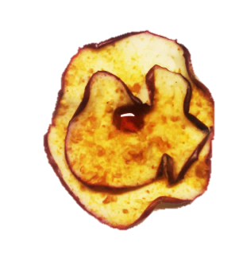
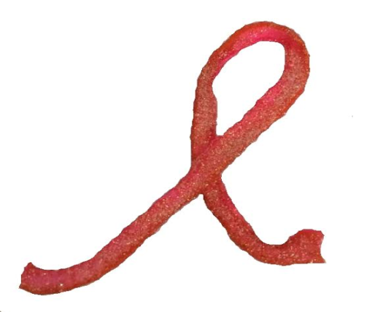
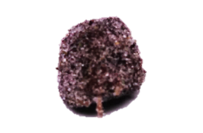
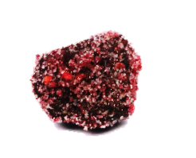
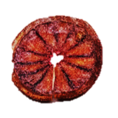
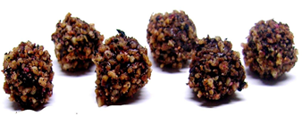
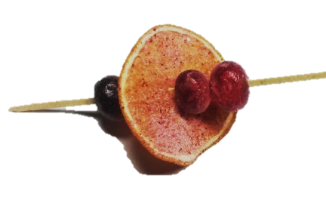
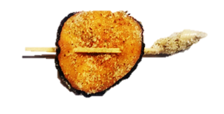
Sample Collection
DTD Newest Garnishes
Infused Ginger Ball’s
Apple Flower Bud
Grapefruit Raspberry Zest Breast Cancer Bow
S'mores Caramelized Chocolate Marshmallows
Candied Blood Orange
Candied Orange Cranberry Pick
Mango Sweet Heat Pick
Plum on Lemongrass stick
No Limitations!
Flavor profiles to meet any beverage creation.
Customized profiles available.

Slide 11
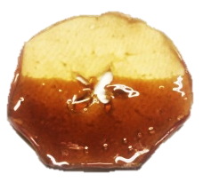
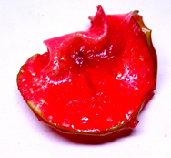
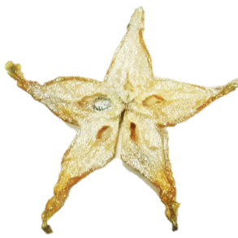
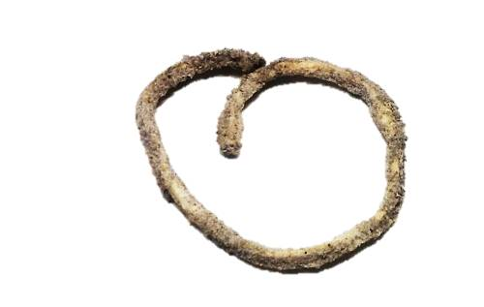
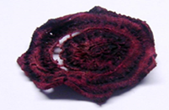
Sample Collection
DTD Newest Garnishes
Blueberry Apple Dot Chip
Candied Red Apple
Root Beer Apple
Golden Star Fruit
Basil Lime Zest Spiral
Candied Beet Ginger Blossom
No Limitations!
Flavor profiles to meet any beverage creation.
Customized profiles available.

Slide 12
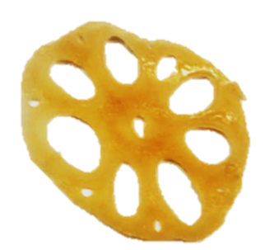
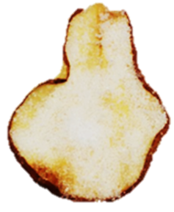
ASIAN BISTRO FLAIR
DTD Newest Garnishes
Peach Lemongrass with Candy Tip
Lotus Root
Sugar Cane -8inch Sticks
Candied Honey Asian Pears
Peanut Butter Sesame
Fig Wrapped Apricot
Jalapeño Coconut Pepper
No Limitations!
Flavor profiles to meet any beverage creation.
Customized profiles available.

Slide 13
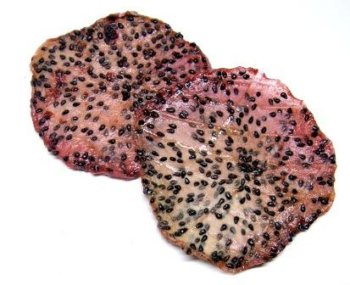
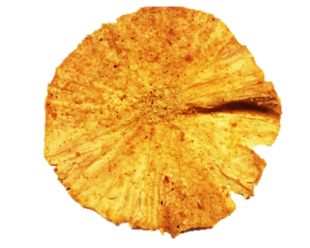
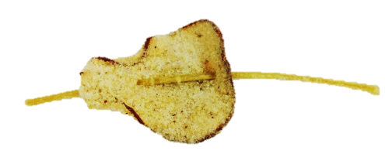
HONEY COLLECTION
DTD Newest Honey Garnishes
Honey Candied Dragon Fruit
Candied Honey Banana Bacon
Candied Honey Pineapple
Candied Honey Pear Ginger Green Tea on Lemongrass
Honey Clusters
Candied Honey Mango Sea Salt
Honey Pop’s
No Limitations!
Flavor profiles to meet any beverage creation.
Customized profiles available.
Honey Icicle Stirrer
Candied Honey Lemongrass Stalk

Slide 14
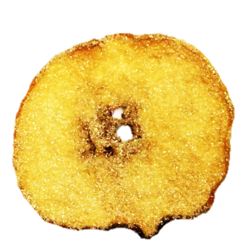
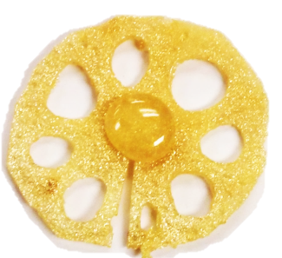
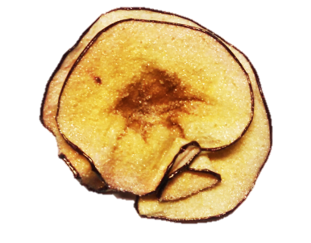
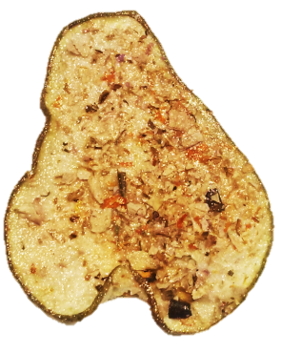
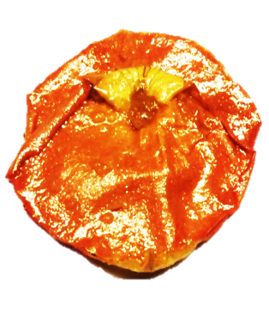
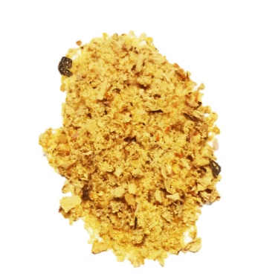
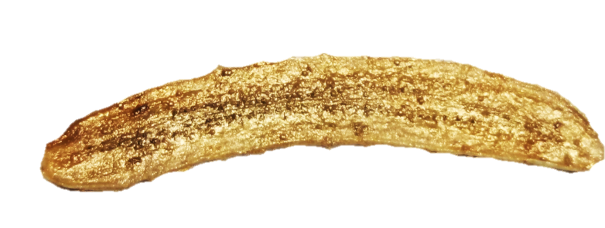
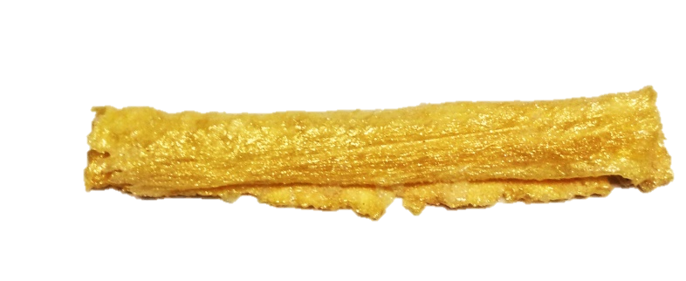
All THINGS …GOLD
Golden Apple
Golden Apple Blossom
Honey Golden Lotus Chip
Golden Flake Blend
Golden Star Fruit Lemongrass Wand
Golden Pineapple Straw
Candied Orange Rose Petal
Golden Asian Pear
22K Golden Banana
Golden Ginger Ball
Golden Icicle Stirrer

Slide 15
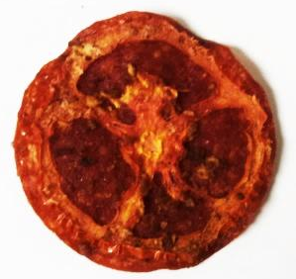
BEEF COLLECTION
DTD Savory Flavor Profiles
Pepperoni with Tomato Slice, Horseradish, and Bacon Blend
Bacon Glazed in Caramel and Habanero
Salami with Cucumber Slice, Basil, Chipotle Pepper and Lime Zest
Bacon Tomato Sweet & Hot with hints
of White Sea Salt and White Cane Sugar
Pepperoni Glazed in Caramel and Horseradish
Bacon Cucumber Basil Lime
Salami Glazed in Caramel, Basil, Chipotle
Tomato Pepperoni Horseradish
Brown Sugar and Habanero

Slide 16
STIRRERS & POPS
With Natural Fruits
4inch- 6inch
Lemon Lime Orange Peach
Strawberry Basil Raspberry Blueberry
Peach Pop Orange Pop
Customized Profile Flavors: Mint, Banana Fig, Wild Cherry, Blood Orange, Pineapple, Strawberry, Hibiscus, Mango, Bacon, Chipotle, Habanero, Red Pepper, Lavender, Peppercorn, Peppermint, Maple, Chocolate, Honey, and so much more…

Slide 17
CARAMEL STIRRERS
4inch- 6inch
Caramel Sea Salt Caramel Bacon Caramel Macadamia Nut
Caramel Espresso Raspberry Caramel Habanero Caramel Pink Peppercorn
Customized Carmel Stirrers Profile Flavors: Butter Rum, Banana Fig, Coconut Peanut Butter, Chipotle, Red Pepper, Maple , Honey, Chocolate, and so much more…

Slide 18
CHAMPAGNE BAR COLLECTION
Elegant to contemporary … So many options…
Try tableside service and see your sales soar…
Edible Gold Flakes
Edible Silver Flakes
Edible Diamonds
Silver Dusted Diamonds
Orange Infused Rose Petal
Crushed Edible Flower I Raspberry Blend
Sugar Lemon Zest Apple Chip
Pineapple Cup
Edible Candied Pansies
Edible Candied Violas
Candied Raspberry Silver Flake Rose Petal

Slide 19
COLD BEVERAGE COLLECTION
COCKTAILS, MOCKTAILS, BREWTAILS & SHAKES
Lemon Chip
Lime Chip
Blood Orange Chip
Orange I Cardamom Chip
Cucumber I Dill Strip
Pineapple I Mint Chip
Peach Round Candied Peach Ring
StarFruit
Apricot I Lemongrass
Pear I Blue Cheese Chip
Cantaloupe I Pink Peppercorn Chip
Apple I Garlic Chip
Apple I Caramel Sippable Edible™
Cantaloupe I Coconut Sippable Edible™
Honeydew I Dill Sippable Edible™
Jicama I Strawberry I Mint Stick
Jicama I Pineapple I Chipotle Stick
Jicama I Mango I Habanero Stick
No Limitations!
Flavor profiles to meet any beverage creation.
Customized profiles available.

Slide 20
BLOODY MARY COLLECTION
Mary has many friends!
Cucumber I Dill Strip
Cucumber I Mustard Chip
Cucumber I Tomato Strip
Tomato I Basil Chip
Onion I Coffee Chip
Green Pepper I Horseradish Strip
Red Pepper I Horseradish Strip
Green Beans I Bacon Strip
Corn I Chipotle Blend
Bacon I Horseradish Blend
Habanero I Salt Blend
Tomato I Salt Blend

Slide 21
SLURP, MUNCH & LOVE NATURALLY…
Yes, it’s a straw!
4inch- 6inch
PATENT PENDING
Apple I Caramel
Honeydew I Dill
Cantaloupe I Coconut
Notes:
New logo with green… Patent pending…

Slide 22
CULINARY BLISS…

Slide 23
DRESS THE DRINK GARNISHES & BLENDS SHELF LIFE & STORAGE
DTD CHOCOLATE PRODUCTS
3 months for optimal freshness. Can be kept up to 6 months while stored in a cool, dry storage area. Summer months require overnight shipping of all chocolate products to avoid melting.
DTD STIRRERS & POPS
12 months while stored in a cool, dry area.
DTD CARAMEL STIRRERS
12 months while stored in a cool, dry area.
DTD EDIBLE VESSELS – SIPPABLE EDIBLE STRAWS
12 months while stored in a cool, dry area.
DTD All NATURAL EDIBLE DIAMONDS
12 months while stored in a cool, dry area.
DTD All NATURAL EDIBLE FLOWERS
12 months with in dry area.
DTD All NATURAL GOURMET SUGAR BLENDS
12 months in dry area.
DTD All NATURAL GOURMET BLENDS without nuts
6 months in dry area.
DTD All NATURAL GOURMET BLENDS with nuts
3 months in dry area.
DTD All NATURAL FRUIT CHIPS
12 months for optimal freshness while stored in dry area.

Slide 24
CONTACT US
Diane Svehlak
President | Partner
949.466.2924 C.
702.270.4346 O.
877.470.4852 TF.
702.446.5210 F.
diane@dressthedrink.com
WWW.DRESSTHEDRINK.COM
Dress The Drink™ ©2014

